Slide 1






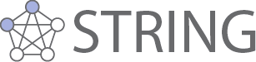
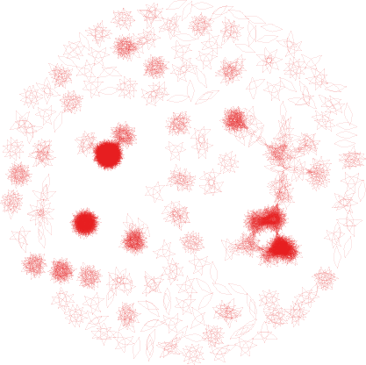
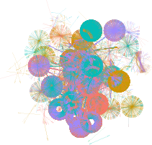
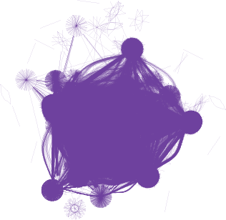
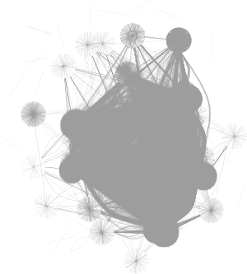
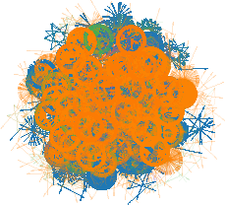
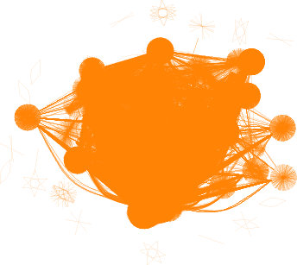

How do our maps look like?
I
R
A
?
A
B
C
B
Proteins only – human only
One canonical isoform – proteoform per gene
<number>

Slide 2
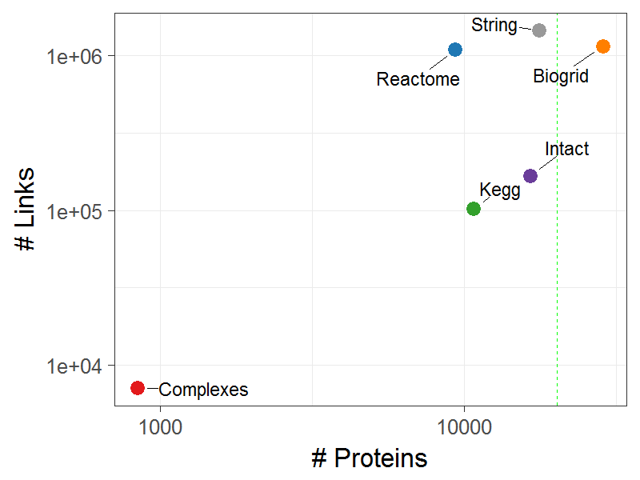
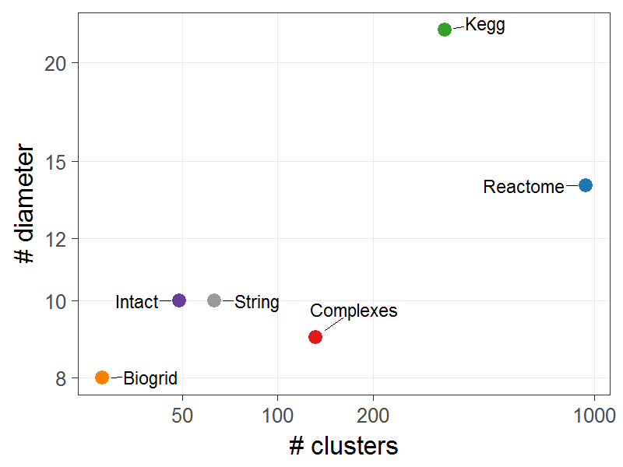
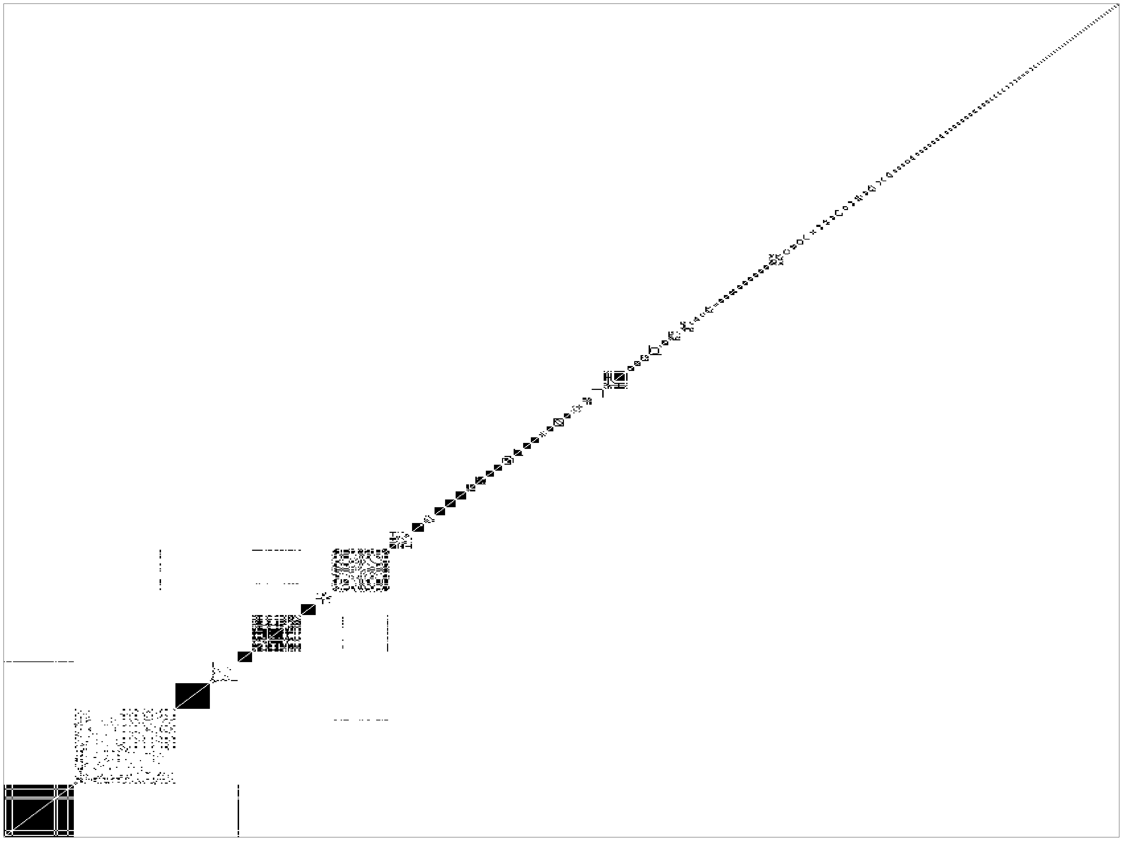
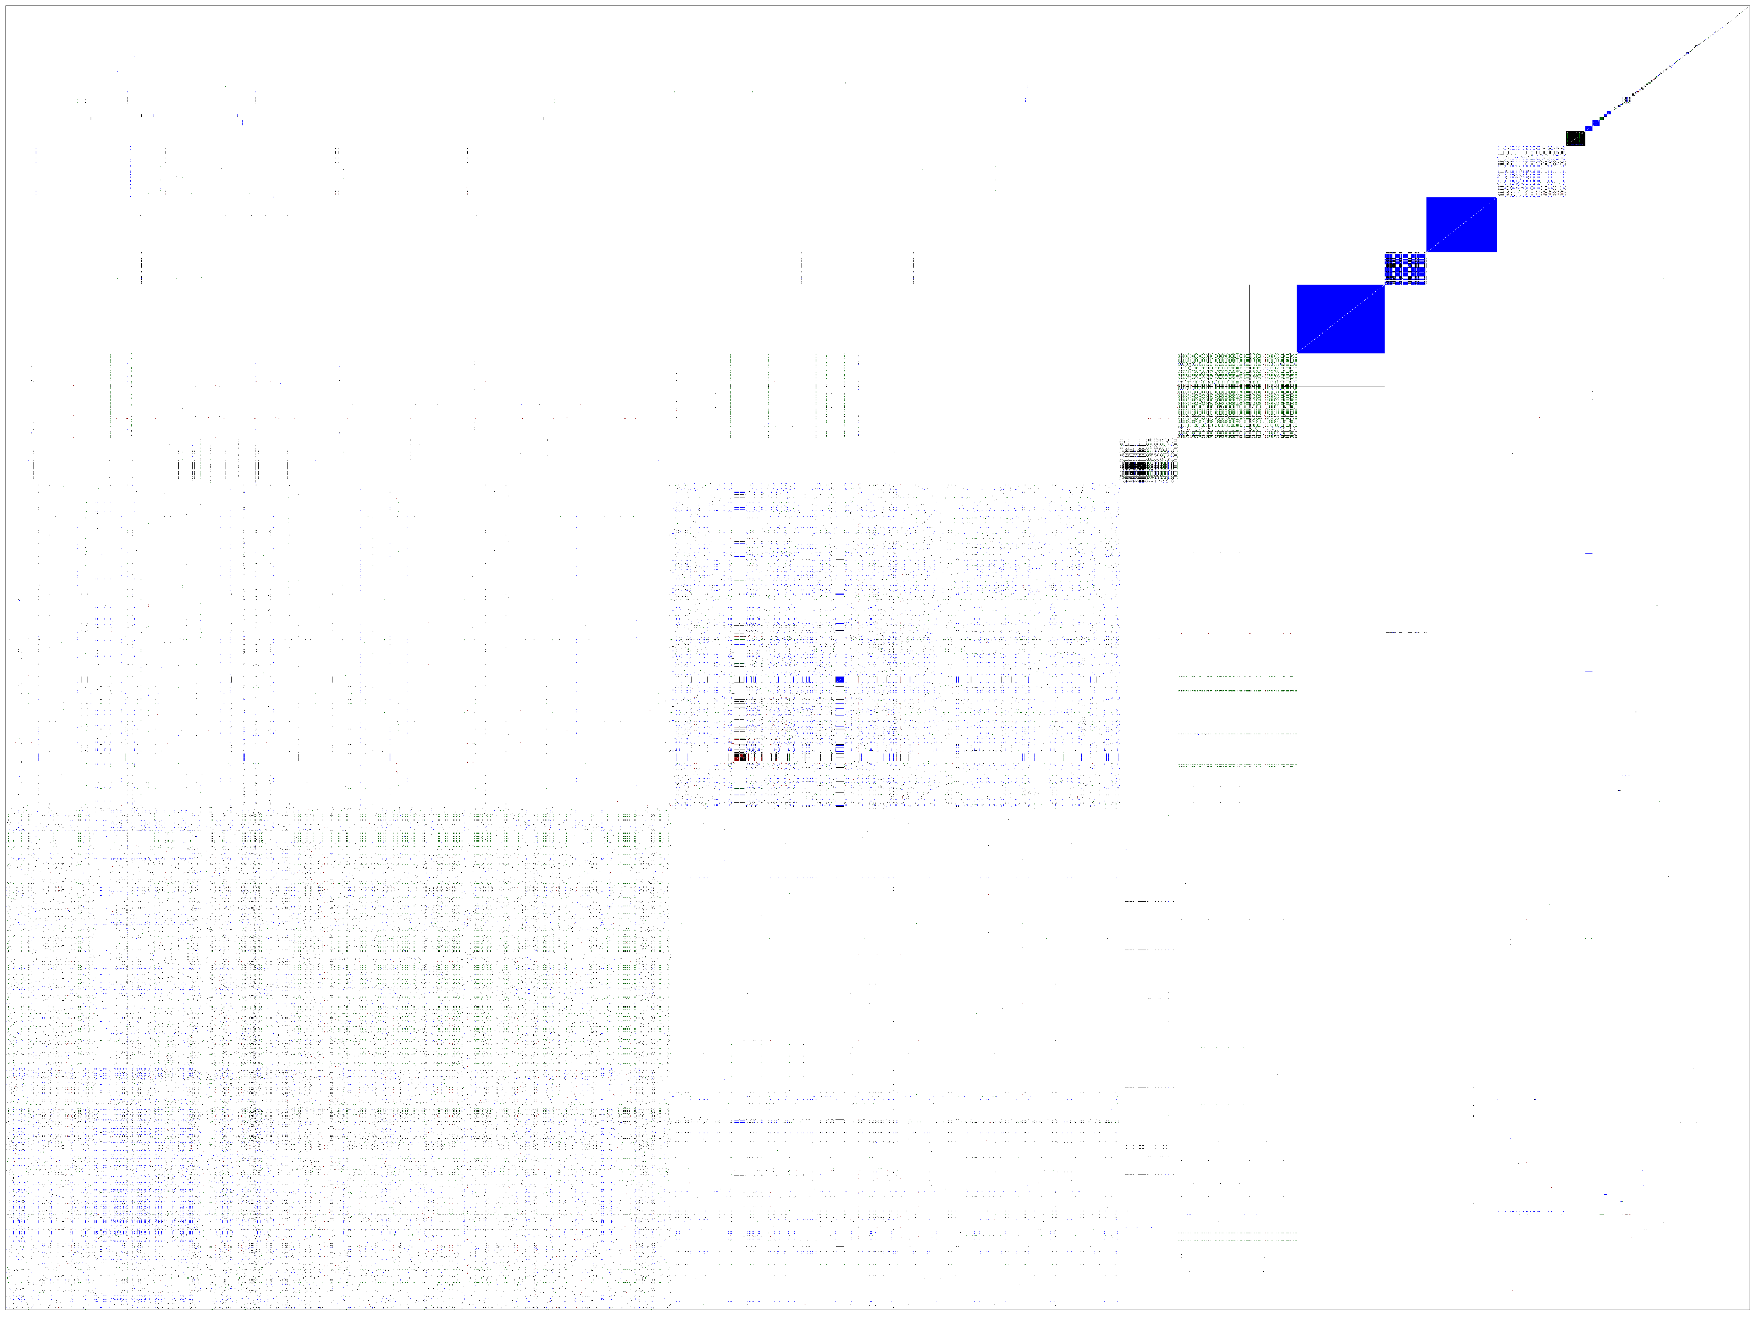
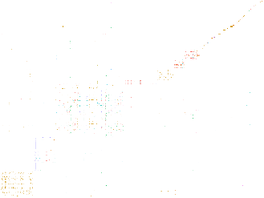
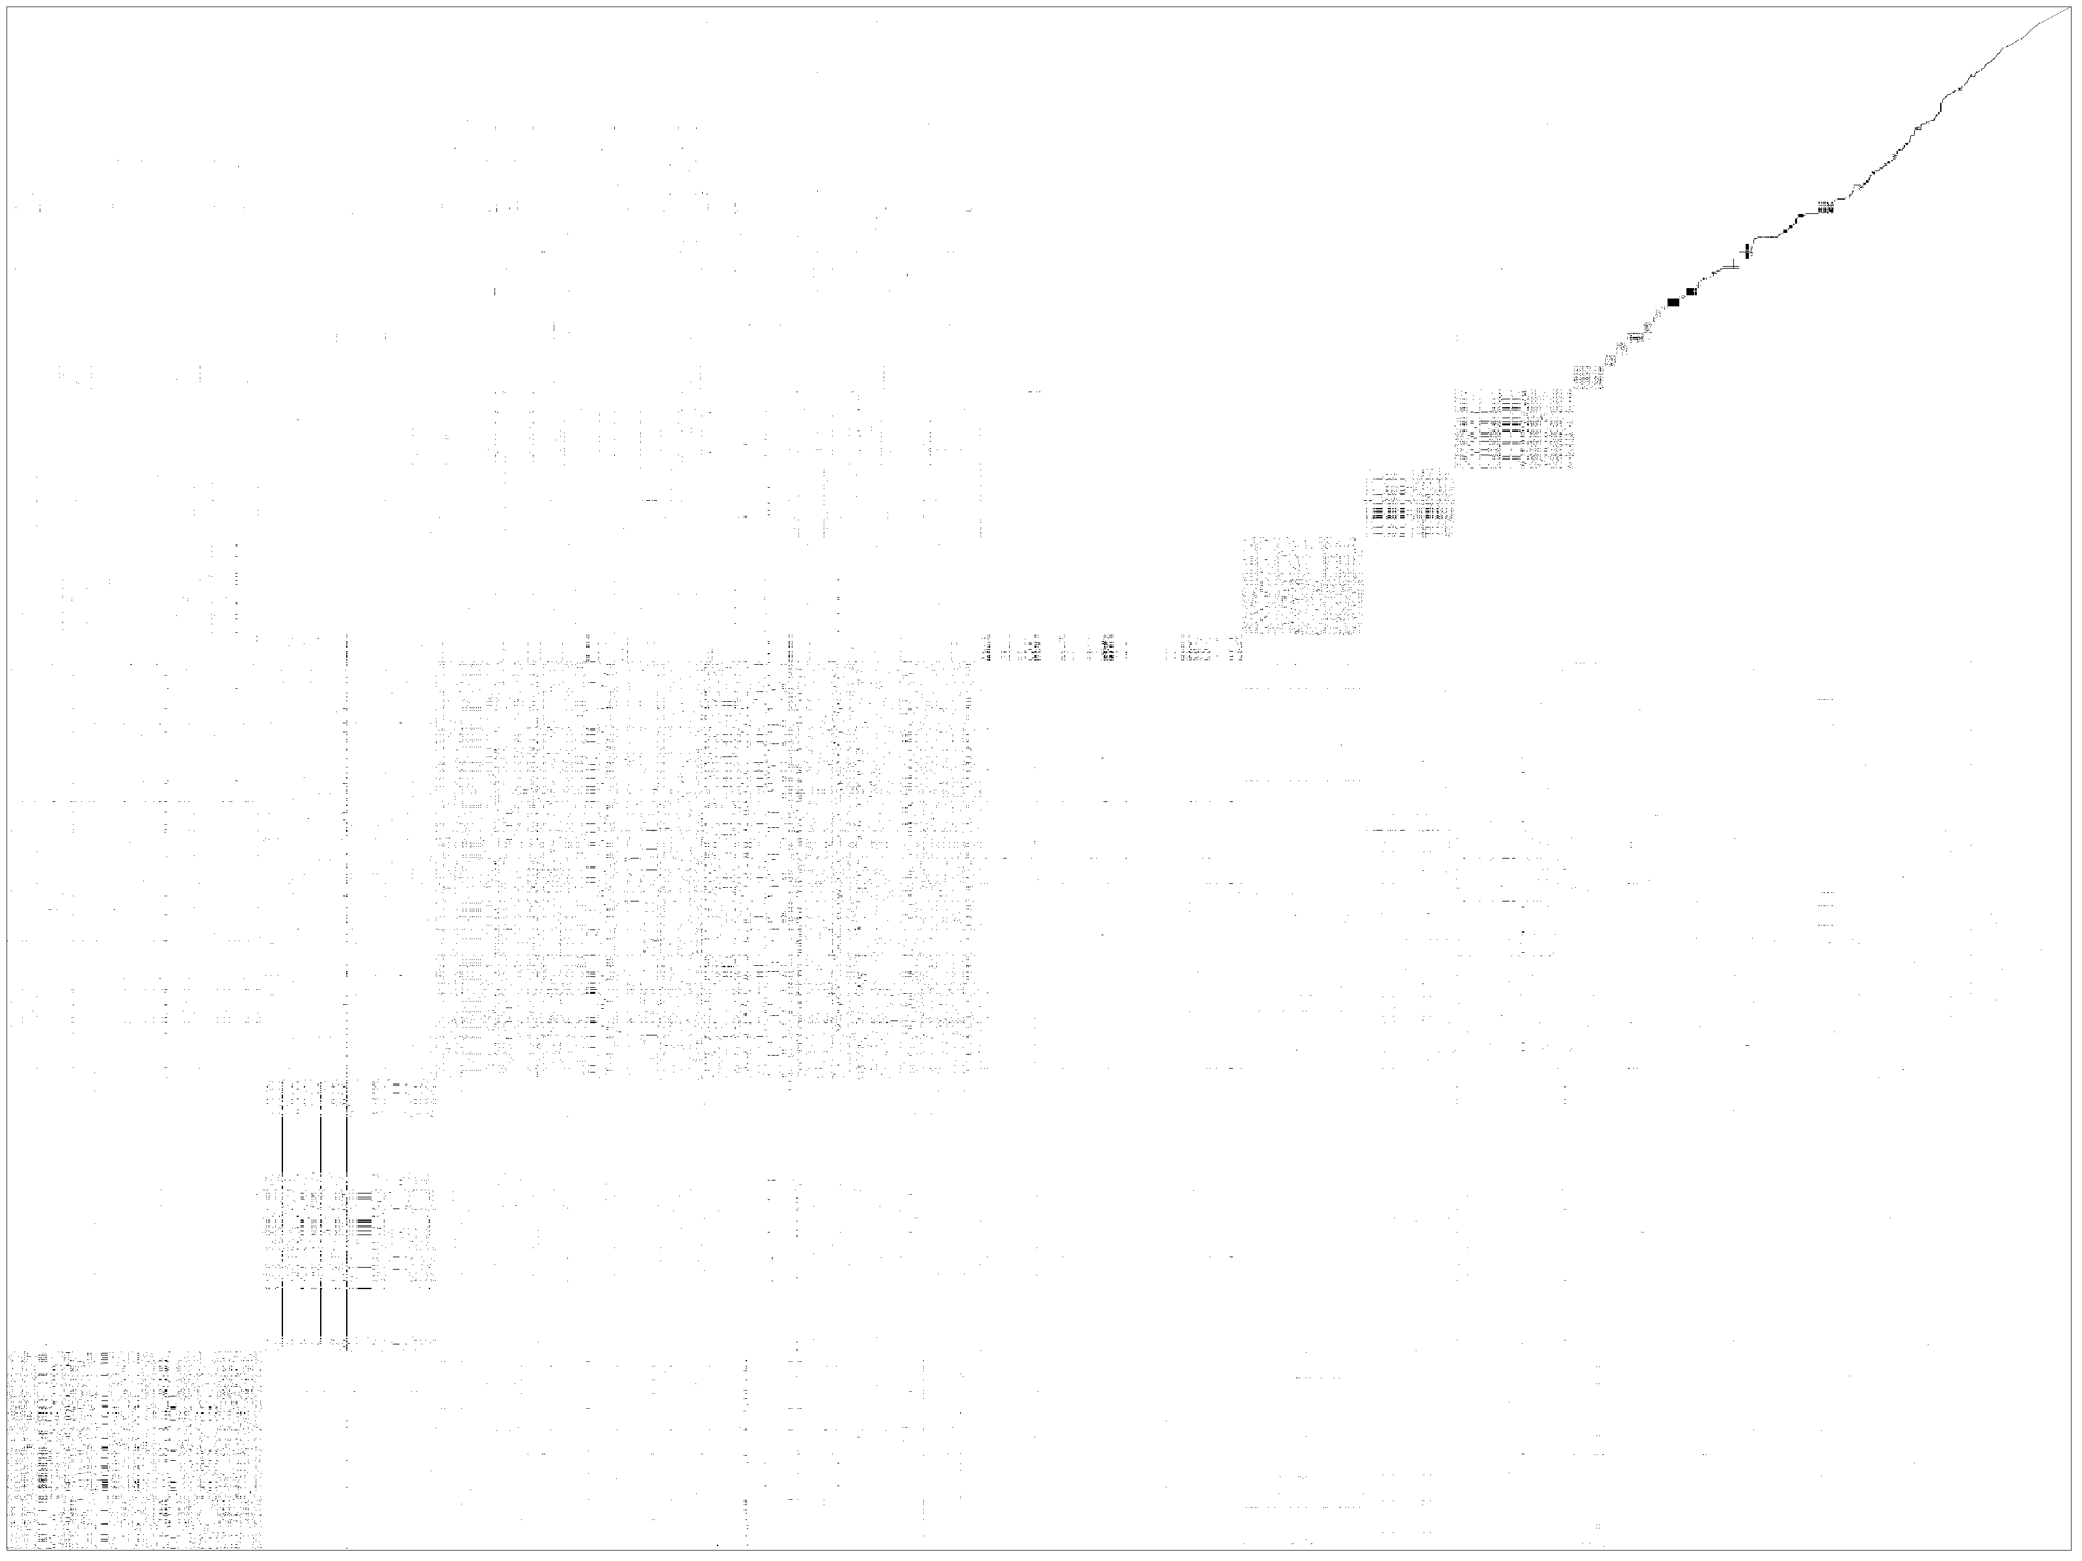



How do our maps look like?
<number>

Slide 3
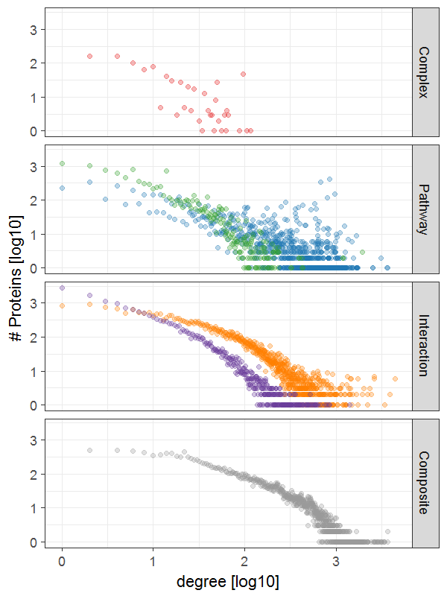
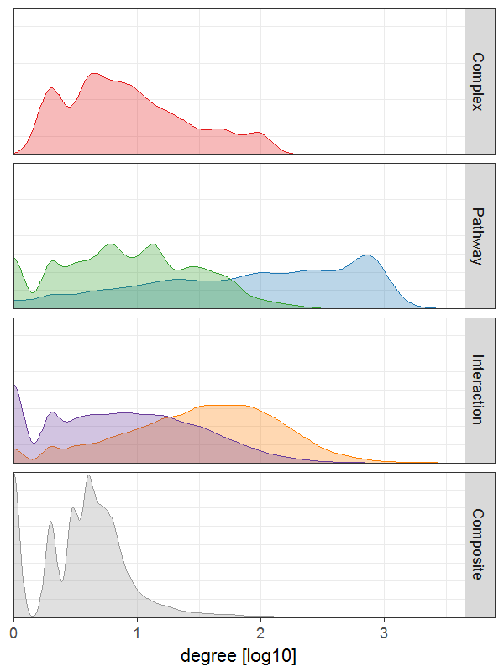
How do our maps look like?
<number>

Slide 4
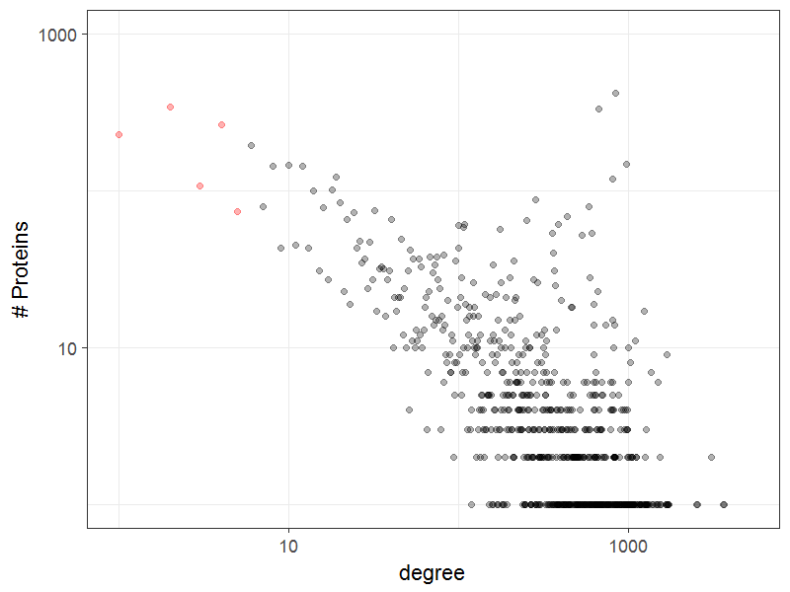
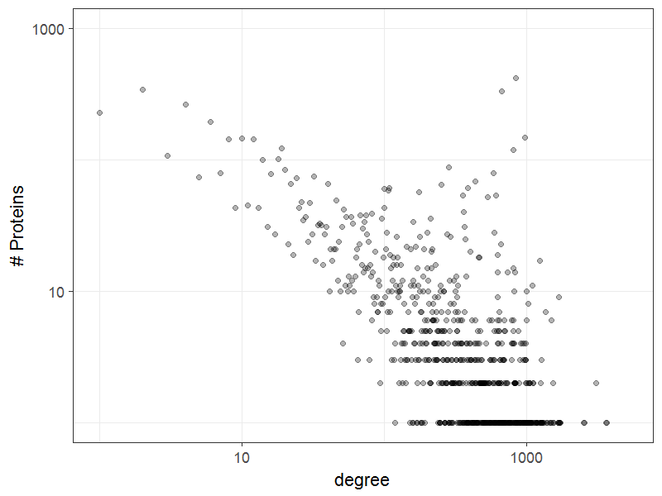
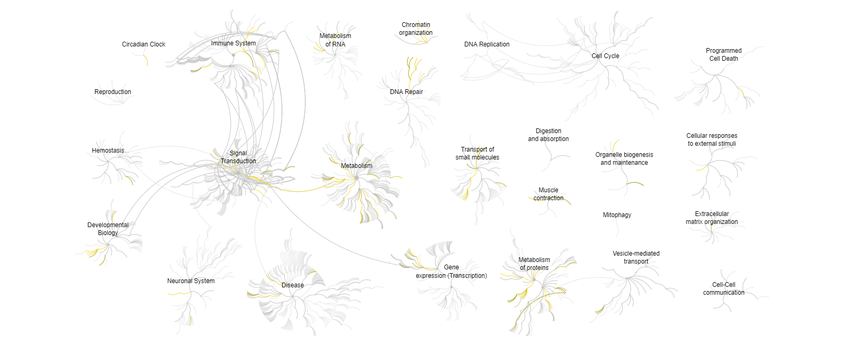
Proteins of Interest
<number>

Slide 5
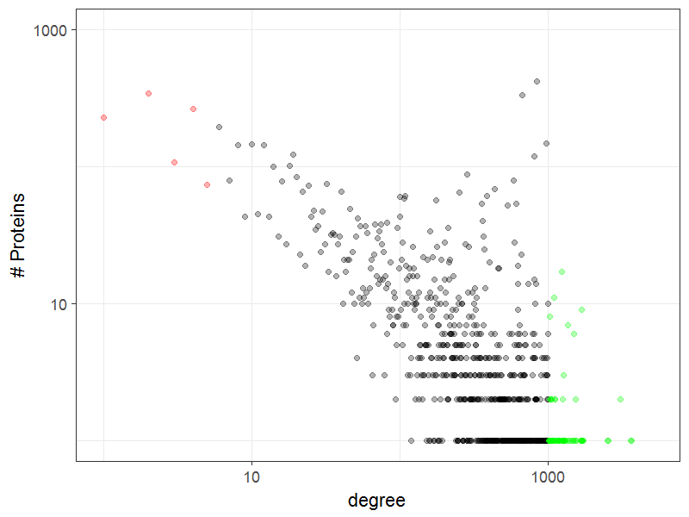
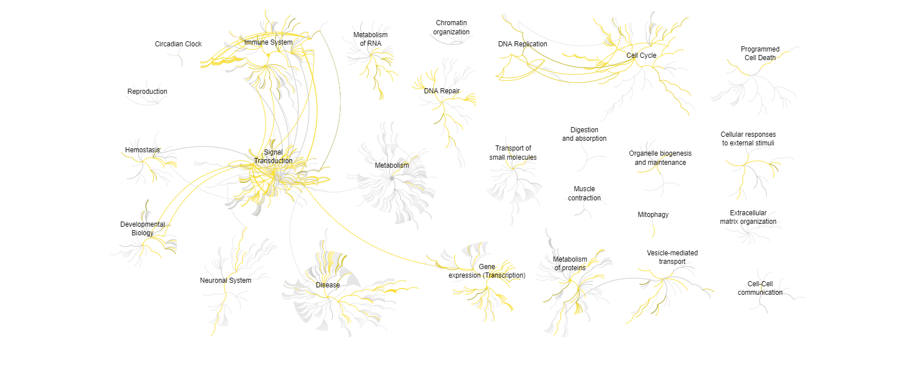
Proteins of Interest
Ubiquitin
Guanine nucleotide-binding protein
DNA-directed RNA polymerase
Tubulin
<number>

Slide 6
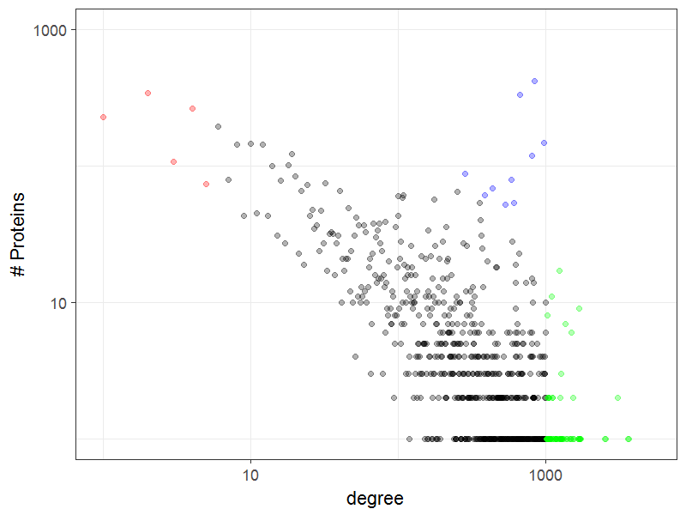
Proteins of Interest
Hydroxytryptamine receptor
Ribosomes
Ubiquitin-protein ligase Immunoglobulin Keratin Zinc finger protein Olfactory Receptor
<number>

Slide 7

Pathway archeology
<number>

Slide 8
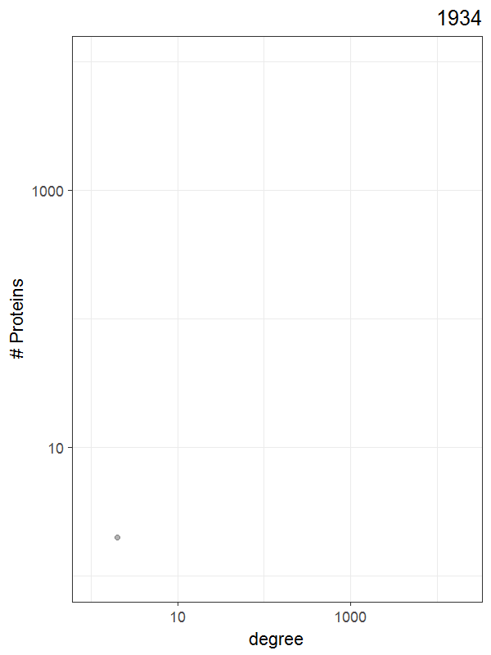
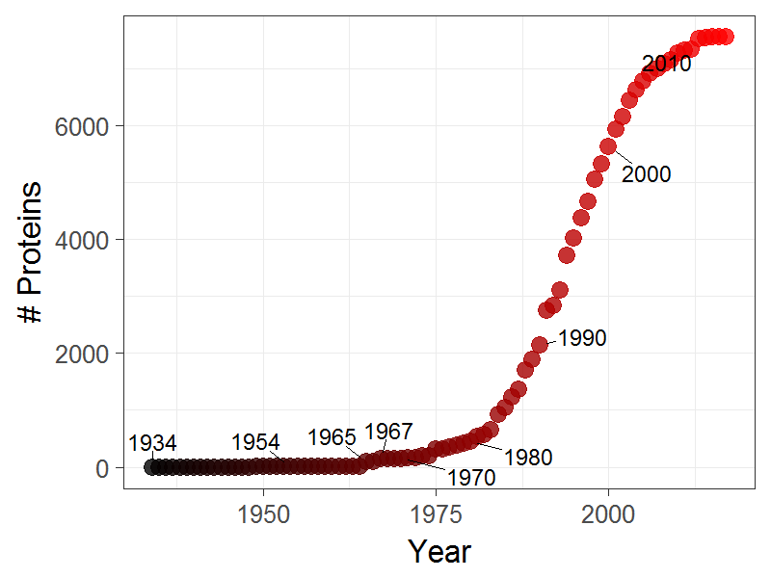
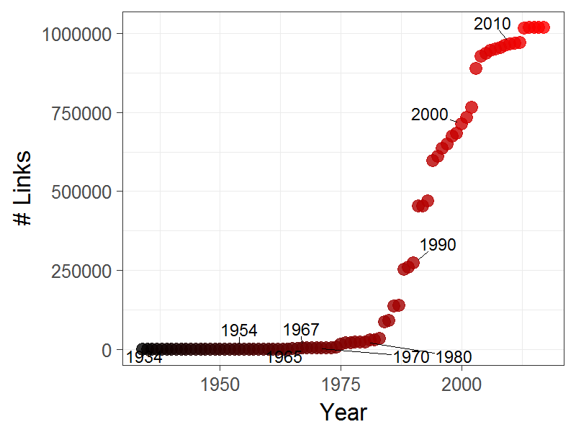
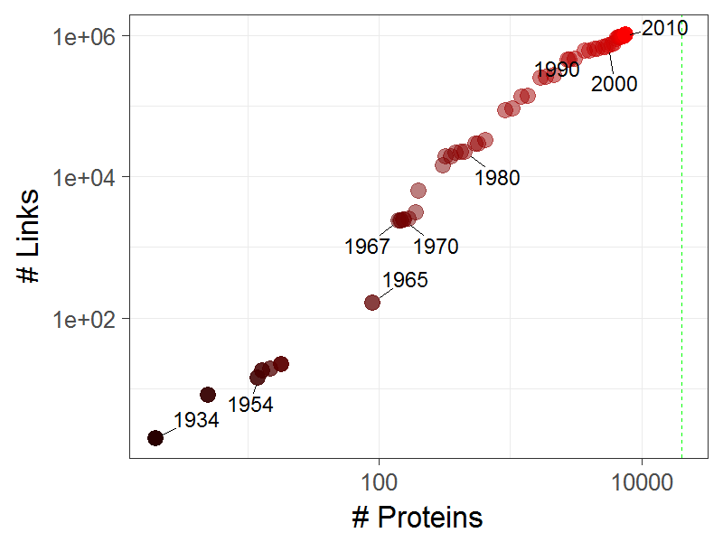
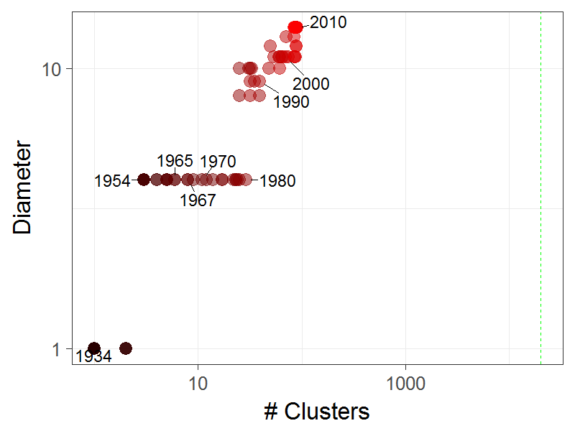
Pathway archeology
<number>

Slide 9
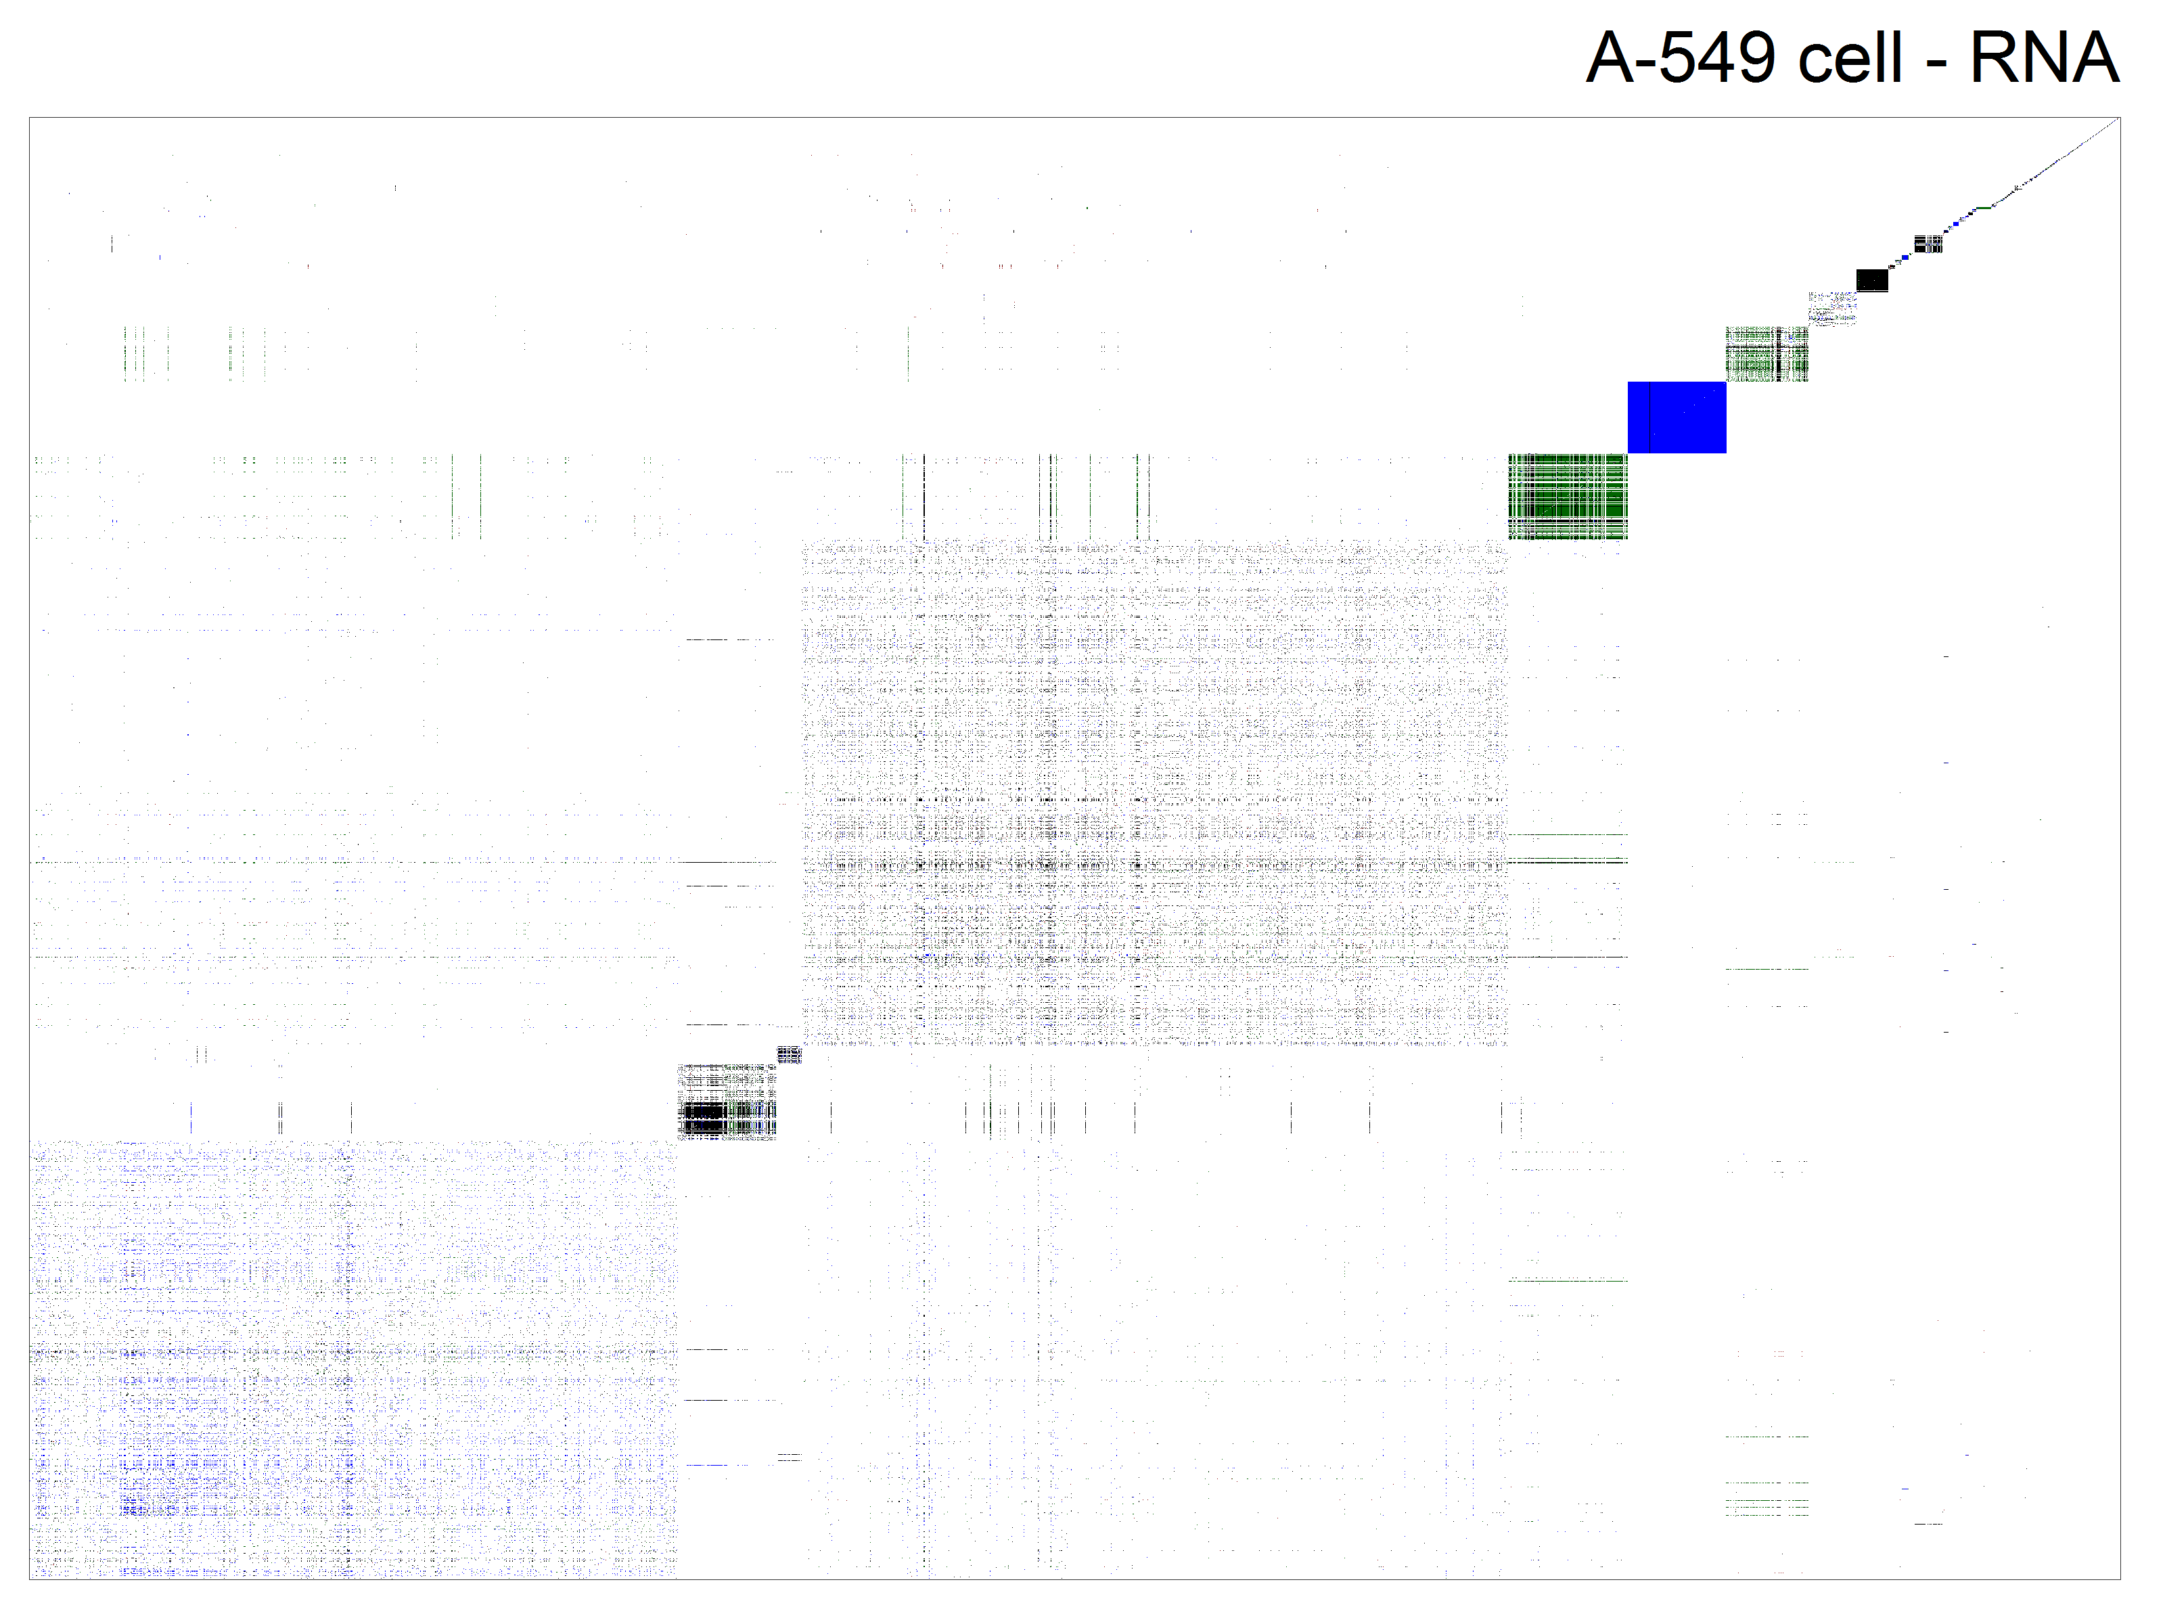
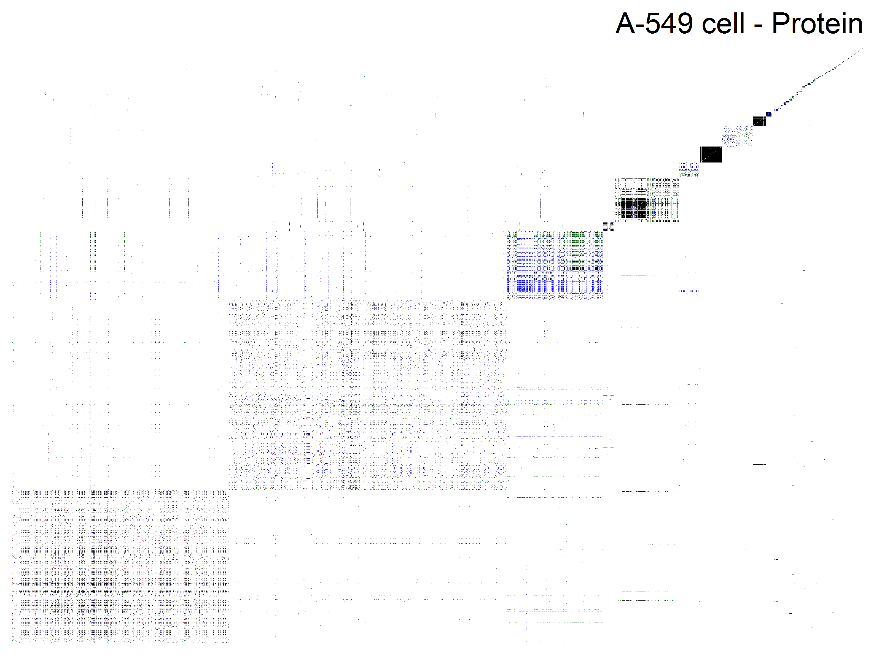
Tissue - Cell Specificity
<number>
RNA: 35/93 Proteins: 35/157

Slide 10
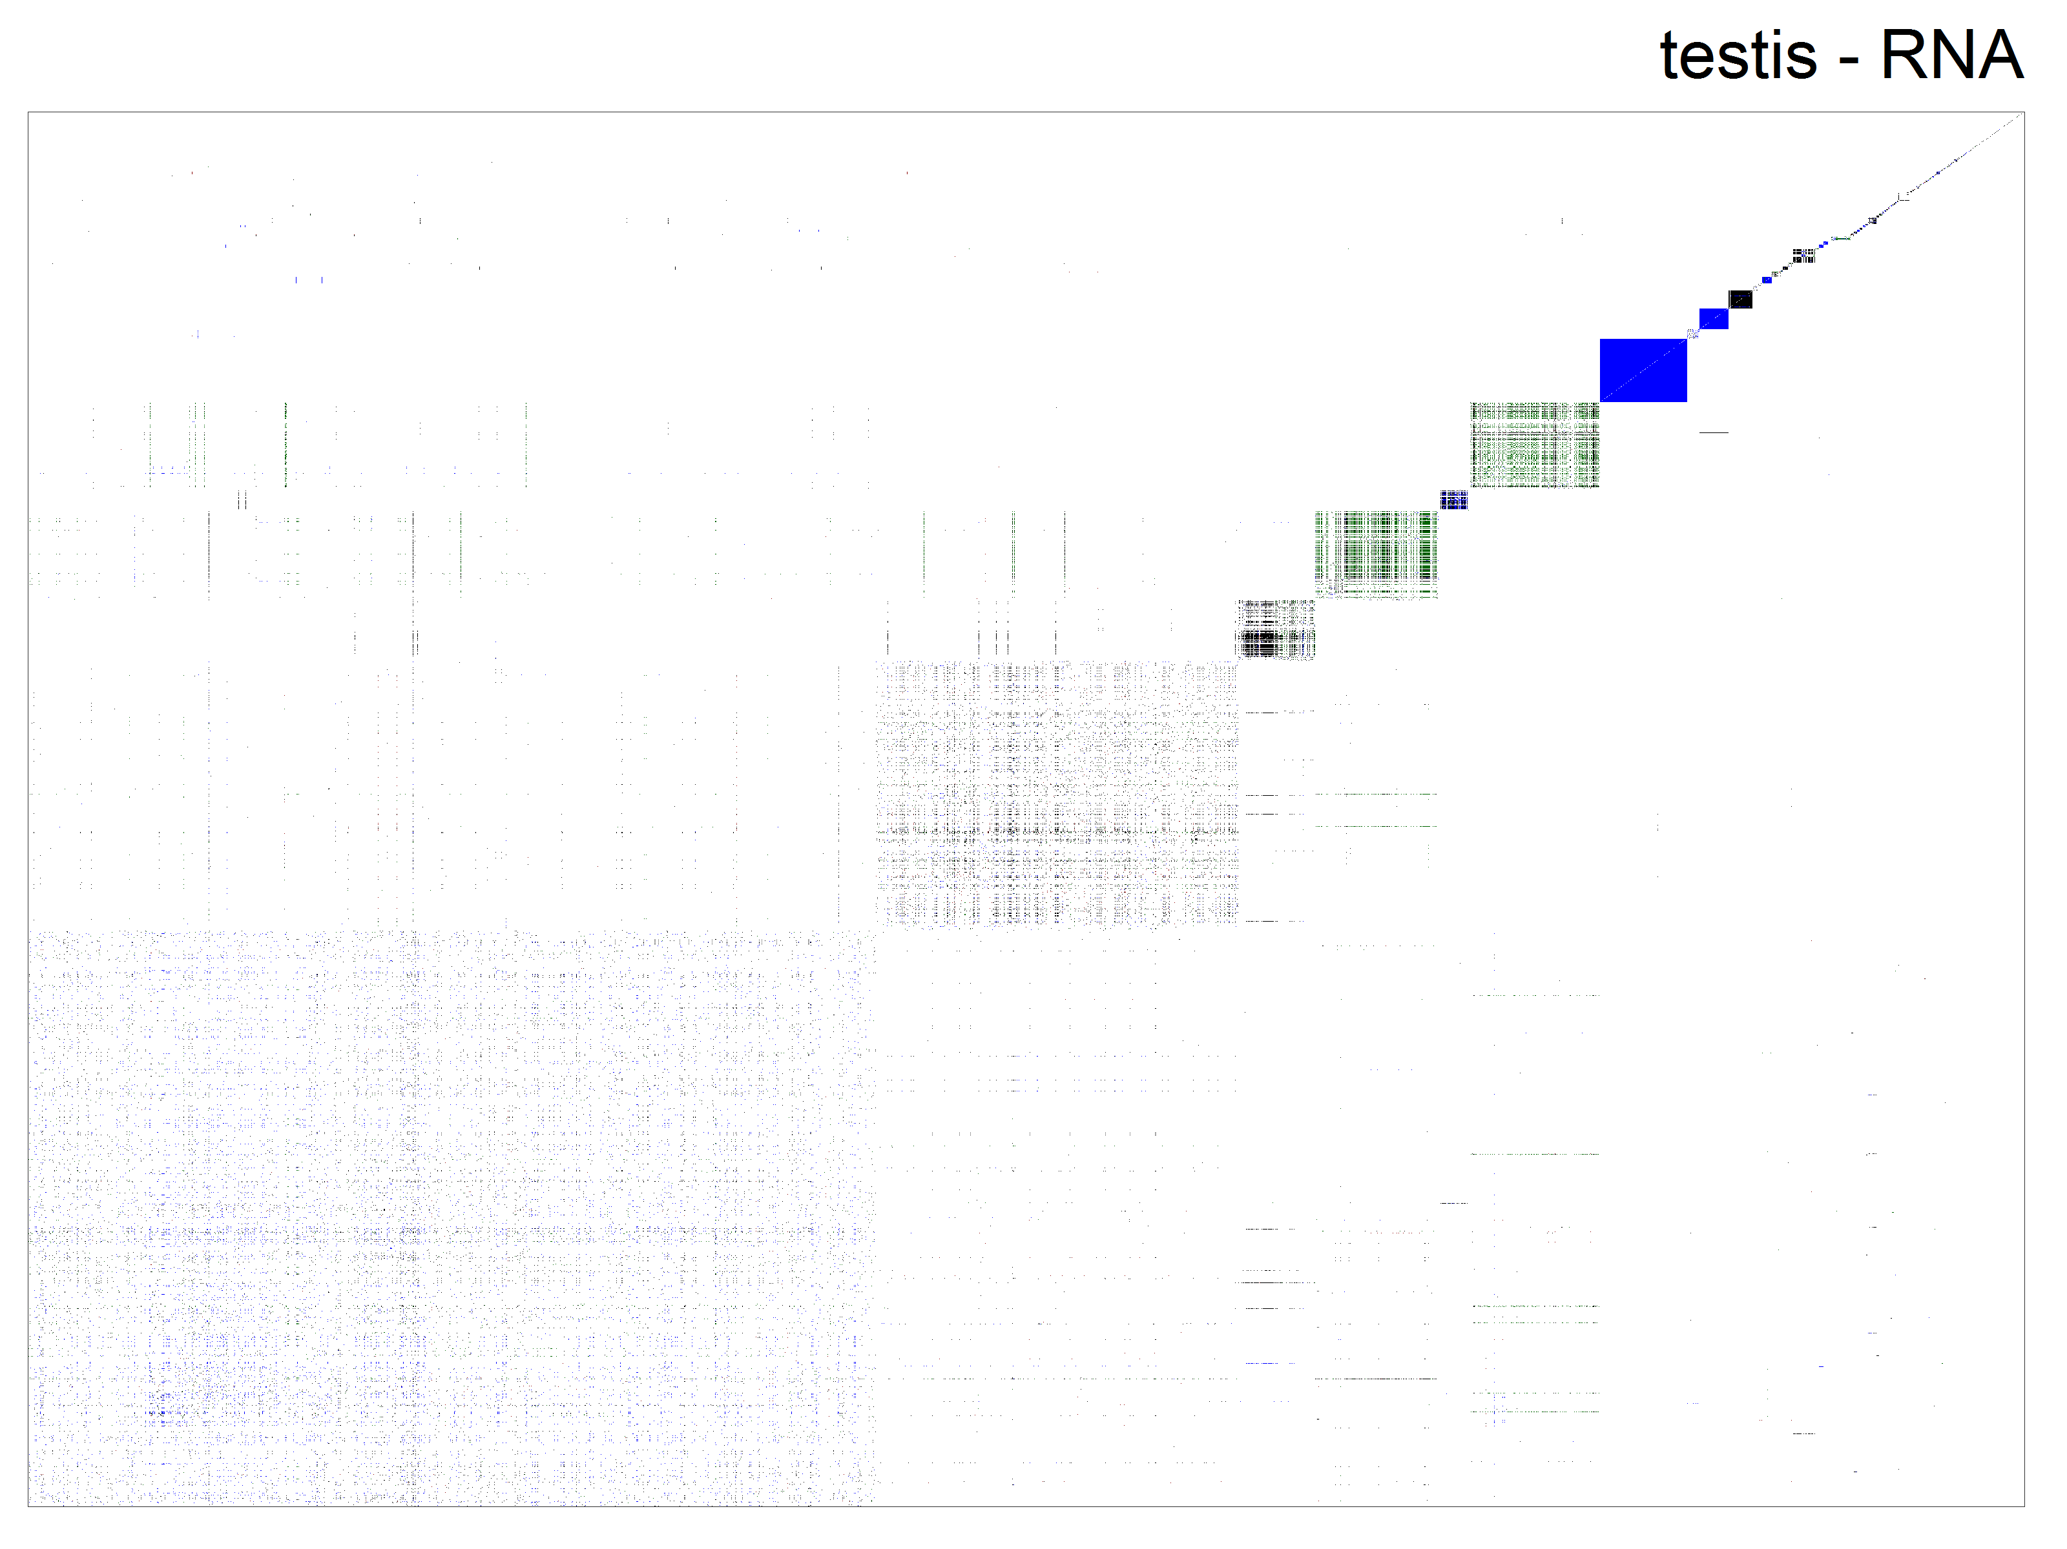
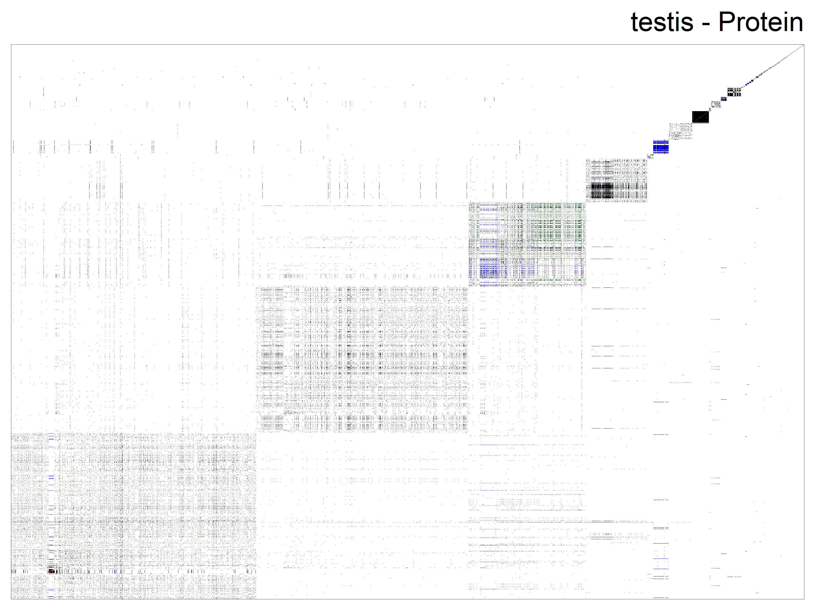
Tissue - Cell Specificity
<number>

Slide 11

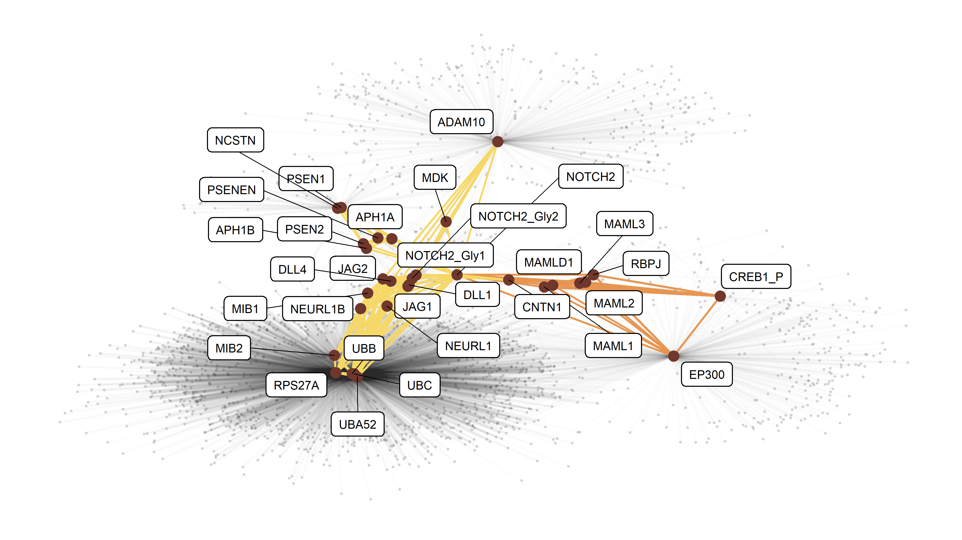
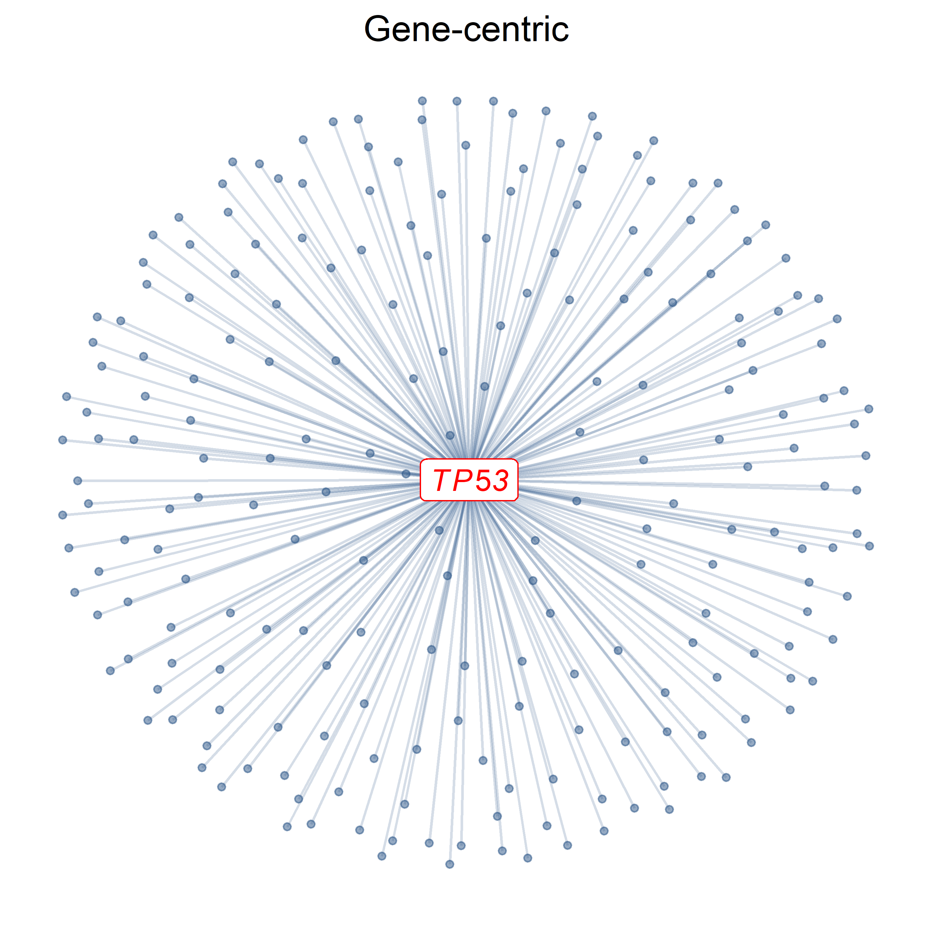
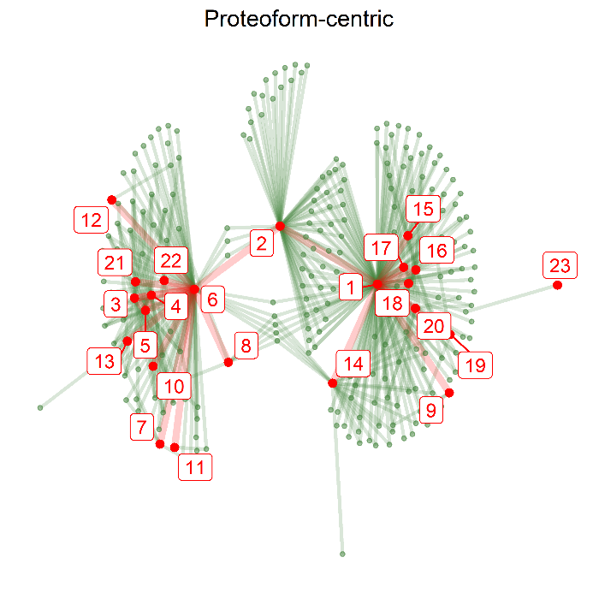
Proteoform Networks
Try it! github.com/PathwayAnalysisPlatform/PathwayMatcher
<number>
DOI: 10.1101/375097
Notes:
<number>

Slide 12
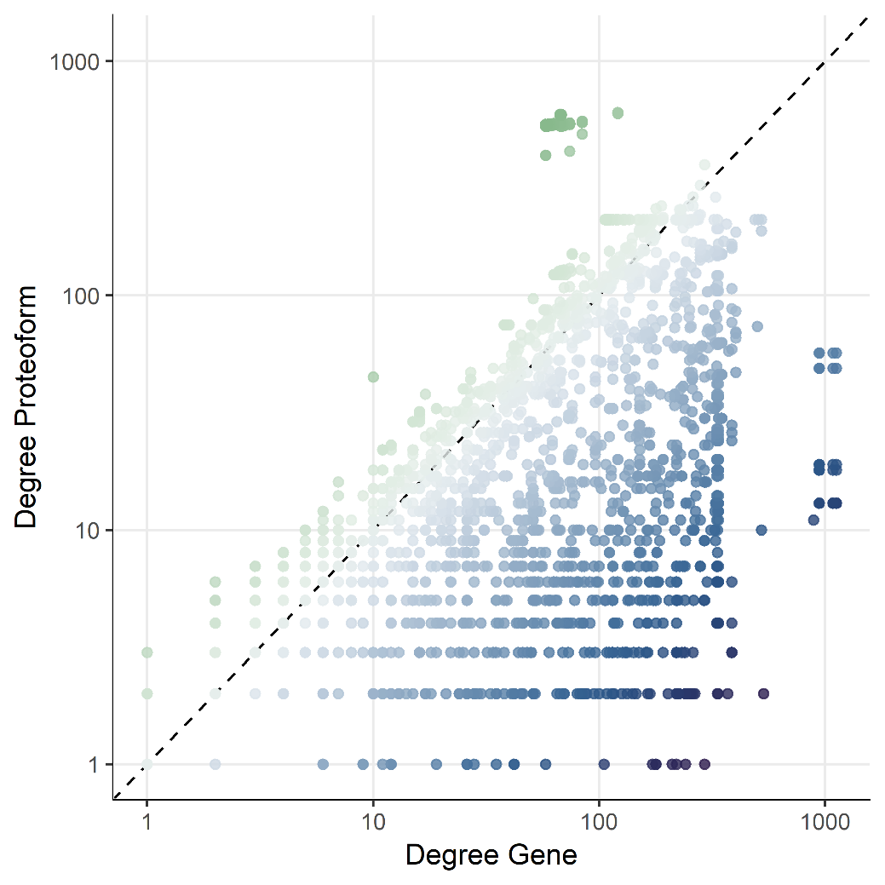
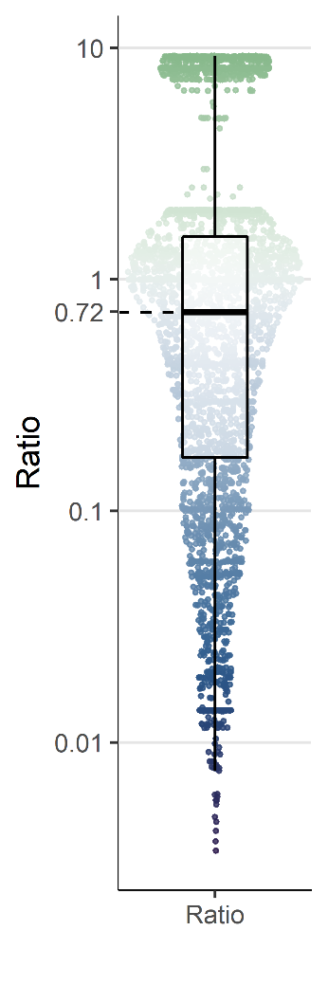
Different Topology
<number>
DOI: 10.1101/375097
Notes:
<number>

Slide 13
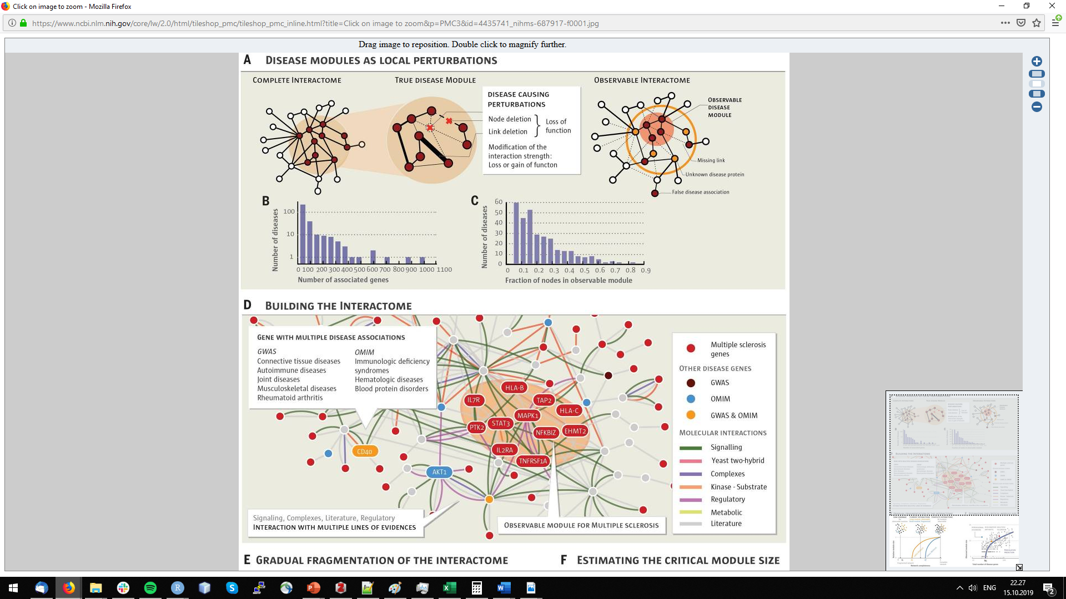
PTM-mediated Network Organization
<number>
DOI: 10.1126/science.1257601
Notes:
<number>

Slide 14
Take home message
No one database/algorithm fits all
Be aware about internal structure prior to analysis
Be careful about underlying object models and identifiers
Use the right level of granularity - coverage for your analyses
Be sceptical, always QC in details
<number>
Notes:
<number>

